Slide 1
Formal hardware verification: challenges and opportunities
Agile hardware center

Slide 2
introduction
The need for better verification

Slide 3
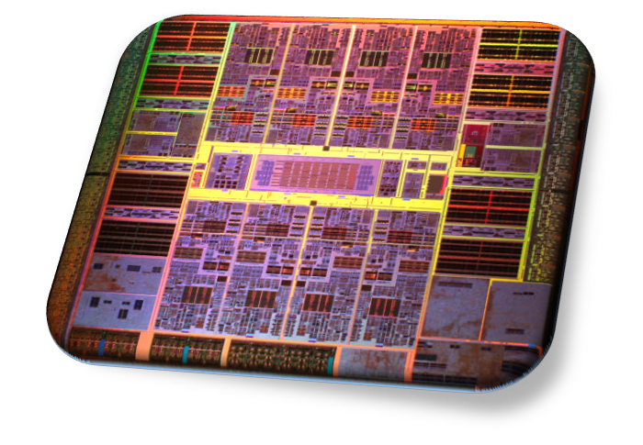
The verification challenge
Systems on a Chip (SoCs)
Growing in size and complexity
Single chip contains multiple cores, caches, accelerators
SoC Verification
SoCs used in critical applications
Correctness is essential
Failures can be extremely costly (Intel FDIV: $500M)
Verification dominates design

Slide 4
Template layout options
All template layout options can be found using the “Insert” tab and choosing “New Slide” dropdown box in PPT.
Slide from DARPA CRAFT proposer’s day

Slide 5
Formal Verification
Has potential to revolutionize verification
Better than testing: covers all possible cases
Already used extensively in industry
But there are many challenges
Three main steps
Create a mathematical model of the system
Specify formally what the properties of the system should be
Prove that the model has the desired properties

Slide 6
Formal Verification
Specification
Verifier
Proof
Or
Bug Trace
Model

Slide 7
modeling

Slide 8
modeling
Good news: HDL descriptions are already a formal model
Challenges
Lack of non-commercial tools that can parse modern HDL’s
Analog / mixed-signal components
Closed-source IP can’t be modeled precisely
Solutions
New open-source toolchains are being developed
AMS circuits can often be approximated by digital circuits
New initiatives to build open-source hardware

Slide 9
Open-source Formal verification Flow
Open Source
Verific
(System-
Verilog)
Yosys
(Verilog)
CoreIR
CoSA
CVC4
(SMT Solver)
Yosys: open-source front-end for Verilog
Optional (commercial) Verific front-end for full SystemVerilog support
CoreIR: “LLVM for hardware” open intermediate representation
CoSA (CoreIR Symbolic Analyzer): open source formal analysis (model checking, bounded model checking)
CVC4: open-source SMT solver

Slide 10
specification

Slide 11
Specification
Challenges for today’s techniques (e.g. assertion-based verification)
Requires design knowledge
Requires manual effort
If incomplete, then will miss bugs
Solutions
Integrated verification and design
Symbolic QED – no manual specification needed
Technique developed together with Prof. Subhasish Mitra

Slide 12
Integrated verification: Equivalence checking
Design
Design’ (after pass)
Constants Folded
Equivalence Property
Encoders
Counterexample
TS1 x TS2
Candidate Lemmas
Equivalence Proof
Equivalence Check via SMT Solving
CoSA
Comparison of a CoreIR design before and after optimization pass
CoreIR optimization pass provides information about constants folded directly to CoSA
Significant performance improvement: 1.3 min vs. timeout (2 h)

Slide 13
quick error detection
Quick Error Detection (QED)
Technique developed by Subhasish Mitra’s group
Uses shadow registers and memory
Applies duplicate and check transformation to improve tests
 | Regular | Shadow
Registers | R0-R15 | R16-R31
Memory | 0x10000-0x1FFFF | 0x20000-0x2FFFF
LD R1, [0x10000]
LD R2, [0x10040]
LD R17, [0x20000]
LD R18, [0x20040]
CMP R1 == R17
CMP R2 == R18
…
LD R1, [0x10000]
LD R2, [0x10040]
…

Slide 14
Symbolic quick error detection
Combines formal methods with QED
Leverages idea of self-consistency (Jones ‘96)
Does there exist any sequence of instructions that would fail a QED test
Searches all possible sequences using bounded model checking
Runs automatically overnight
Some results
OpenSPARC T2: found 92/92 tough bugs automatically
Few minutes to few hours each
Each found bug returned a bug trace of less than 10 instructions
RIDECORE: (open-source out-of-order Risc-V core)
Found previously unknown bug
Bug was reported and fixed

Slide 15
Symbolic quick error detection
Surprisingly, can be made into a complete technique
SQED can, in theory, find all bugs in a processor core
Limited only by the power of the bounded model checker
Can be extended beyond processor cores
Same idea can be used for accelerators
Instruction-level abstraction (ILA) developed by Malik and Gupta at Princeton makes accelerators look like processors
Techniques for scaling up (work in progress)
Symbolic initial states
Automatic design partitioning
Abstraction of uninteresting components

Slide 16
proving

Slide 17
Proving
Challenges
Manual proofs require enormous effort
Automated techniques limited to small designs
Solution:
Better Solvers!

Slide 18
Evolution of SMt solving
Quantifier-Free Bitvector (QF_BV) SMT-LIB benchmarks
Comparison of virtual best SMT solvers since 2010
Evaluation on 39610 benchmarks (SMT-LIB 2018)
41 different families of benchmarks

Slide 19
Evolution of smt solving
Total time (virtual best)
Average speedup: 11X
Unsolved (2010): 3100
All but 200 solved now
Over 2000 now solved in less than 1 second

Slide 20
How will we get even better solvers?
Leverage SAT technology
SAT solvers also improving each year
Build better SMT solvers
More powerful rewriting and algebraic reasoning
New SMT theories
Specific optimizations for bounded model checking
Parallel computing
Machine learning

Slide 22
Agile hardware flow
High-level Functional Definition
Halide
Yosys (Verilog)
…
Intermediate Circuit Representation
CoreIR
Bitstream CGRA configuration
Place and Route
Improve hardware design productivity with ideas from software
Start with a high-level description language for image processing, e.g., Halide
Uses CoreIR as a representation throughout the flow
Allows for multiple front-ends such as Yosys
Inspire design re-use and innovation by providing open-source toolchain

Slide 23
Model Checking (Commercial Tools)
CoreIR Symbolic Analyzer (CoSA)
System Model
Properties
System Model
Design Information
Properties
Model Checker
CoSA Model Checker
SAT Solver
SMT Solver
Model and Properties as single entry point to the model-checker
Bitblasting loses word-level structure
Black-box usage of SAT solver
Closed source
BMC and k-induction engines
Leverages CoreIR circuit representation developed as part of Stanford agile hardware (AHA) project
Can make use of additional design information to optimize verification
Maintains word-level structure by using SMT theories
Uses customizable SMT solver developed by Barrett group at Stanford
Entire toolchain is open-source

